Slide 1
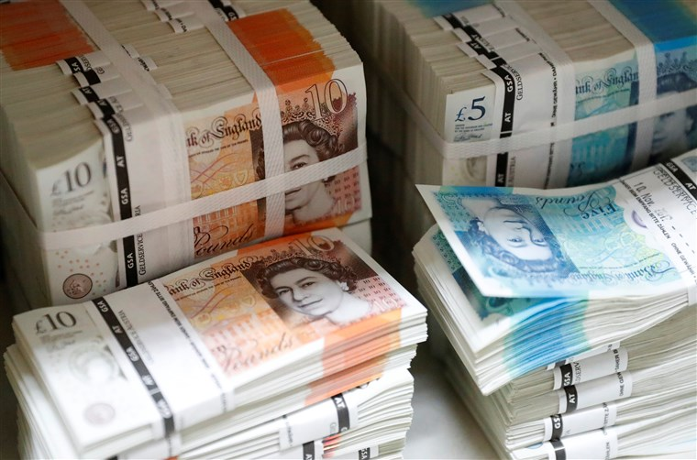
WHAT IS MONEY?

Slide 2
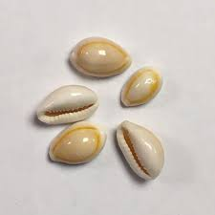
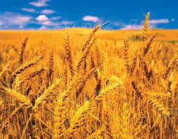
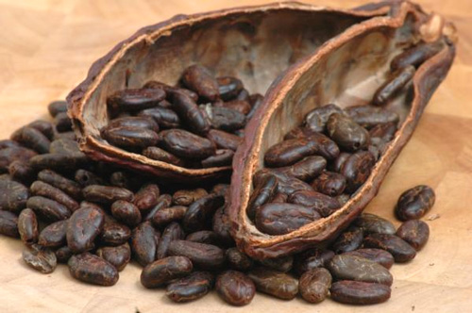
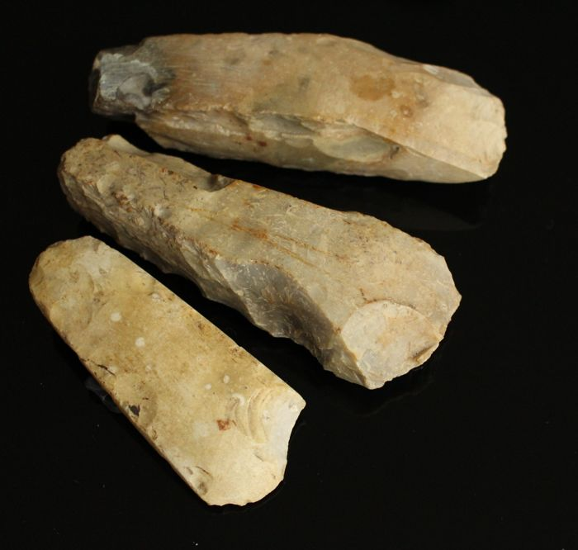
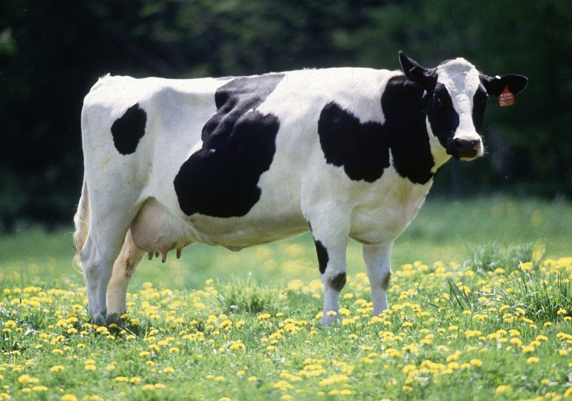
WHAT DO THESE OBJECTS HAVE IN COMMON?
MoE

Slide 3
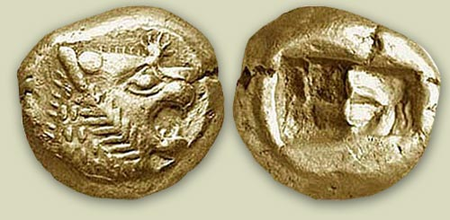
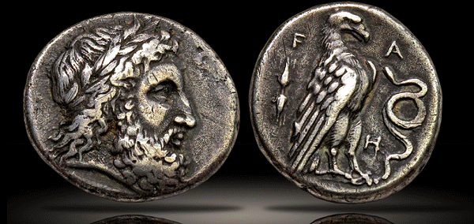
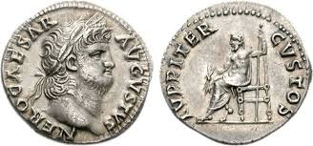
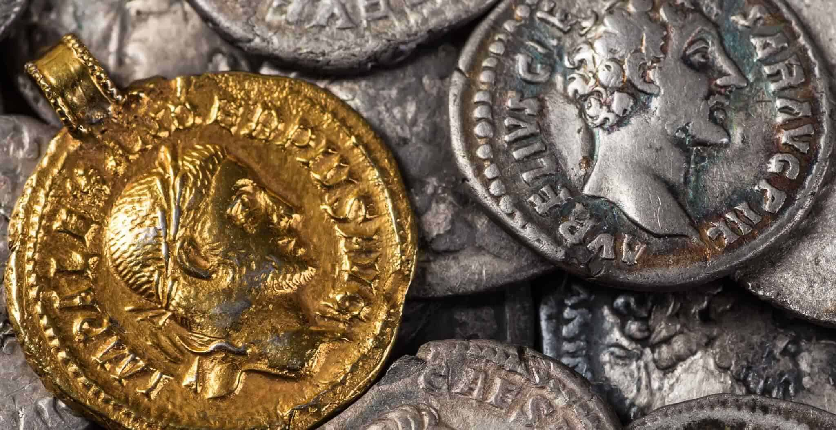
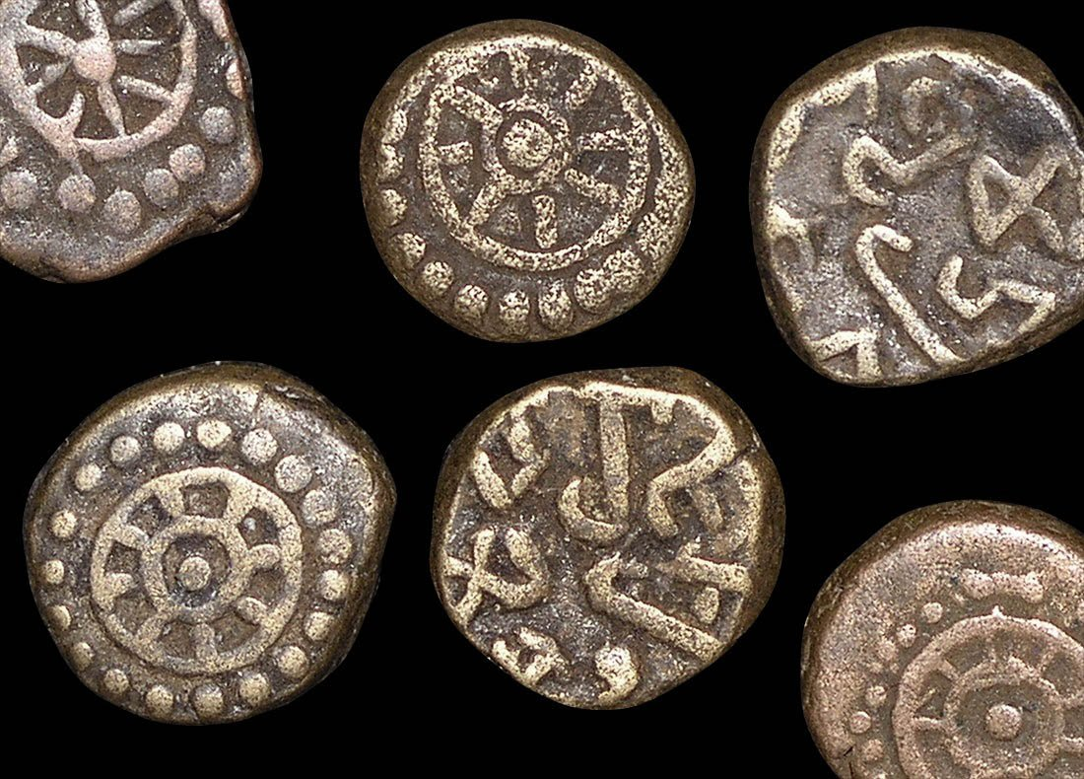
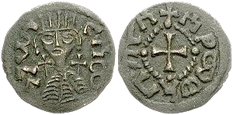
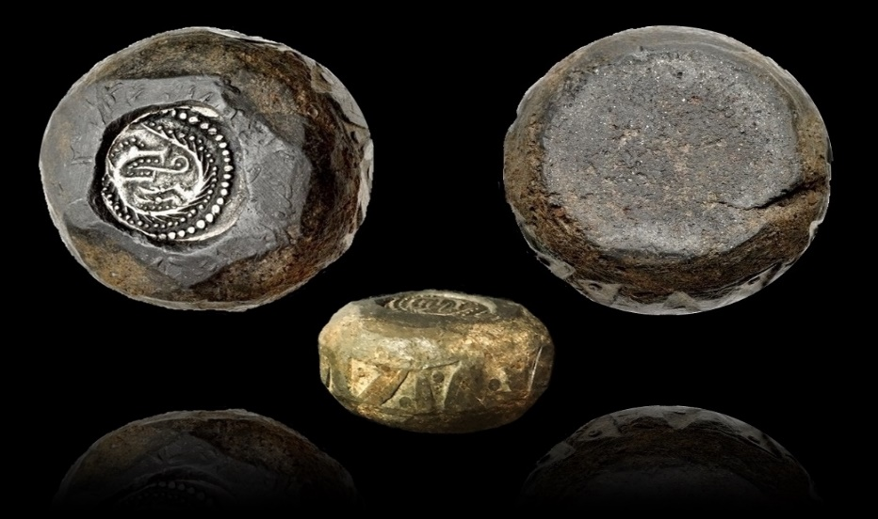
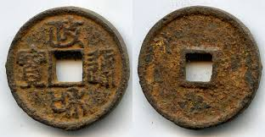
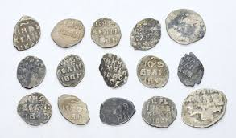
Lydia (present day Izmir), 600 BCE
Greece, 400 BCE
Rome, 10 CE
COINS AS MEDIA OF EXCHANGE
Roman Britain, 200 CE
India, 350 CE
Ethiopia, 900 CE
Viking Britain, 900 CE
China, 1100 CE
Russia, 1700 CE

Slide 4
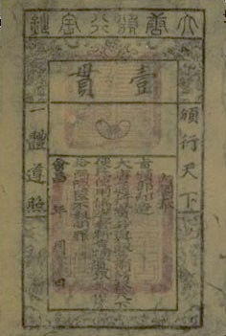
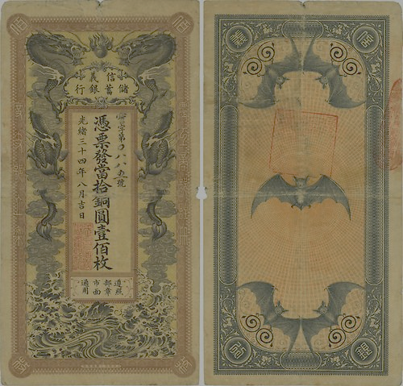
PAPER AS CURRENCY
CHINA IS WHERE MONEY ACQUIRED THREE MODERN FEATURES
PAPER (TANG DYNASTY, 600 CE)
STATE MONOPOLY (SONG DYNASTY, 1000 CE)
FIAT ISSUANCE (CHIN AND YUEN DYNASTIES, 1115-1368 CE)
BUT IT DID NOT LAST (OVER ISSUANCE)

Slide 5
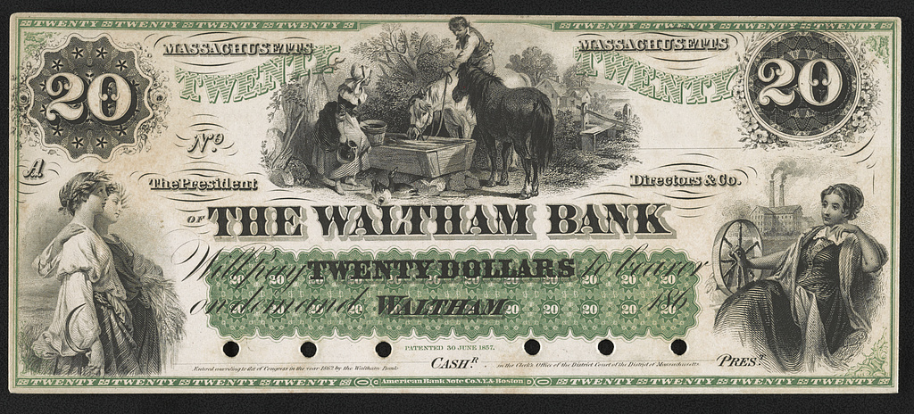
WHAT IS UNUSUAL ABOUT THIS $20 NOTE?
Notes:
Is not issued by a central bank

Slide 6
days
Metres
seconds
$
minutes
radians
OUNCES
inches
Kg
Pounds
£
Feet
€uros
YEARS
Hours
degrees
WHAT DO THE ABOVE HAVE IN COMMON?
Notes:
All are units of measurement

Slide 7
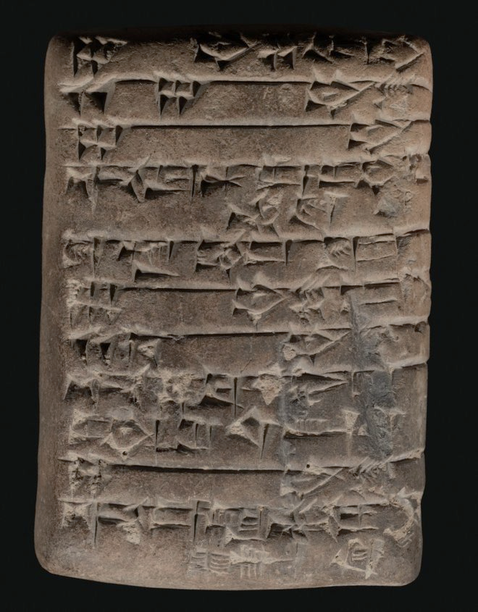
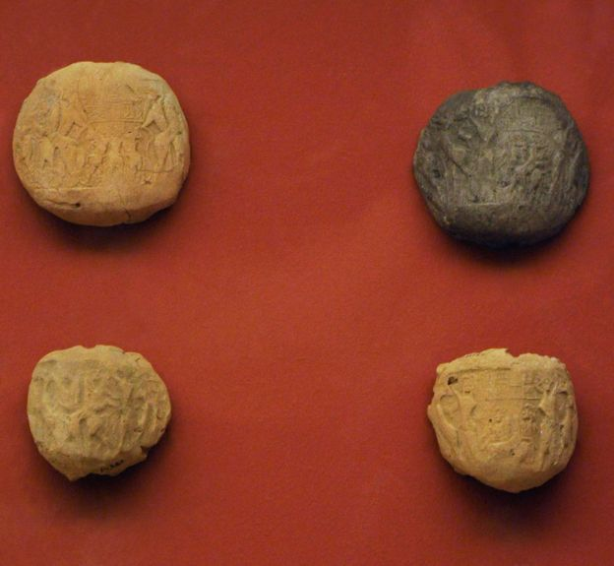
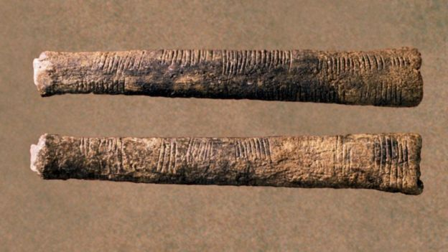
Mesopotamian Bulla
6000 BCE
Ancient Accounting Methods
Mesopotamian Cuneiform
Tablet, 3500 BCE
Congolese Tally Sticks, 18000 BCE

Slide 8
Gross national income at current prices (million GBP)
2018 | 2123051
2019 | 2231667
2020 | 2058523
2021 | 2299051
2022 | 2540238
2023 | 2698611
MODERN ACCOUNTING
WHAT IS THE BIG CHANGE?
Notes:
MONEY IS USED AS THE UNIT OF ACCOUNT

Slide 9
WHAT DO THESE IMAGES HAVE IN COMMON?
Notes:
ALL ARE FORMS OF ACCUMULATING WEALTH

Slide 10
WHAT SHALL YOU STUDY IN THIS MODULE?
A FORMAL ANALYSIS OF THE ROLE OF MONEY IN AN ECONOMY
HOW THE UNIT OF ACCOUNT ROLE LEADS TO THE MACROECONOMIC
CONCEPT OF THE “PRICE LEVEL” (WHICH IN TURN IS IMPORTANT FOR
UNDERSTANDING INFLATION).
HOW AND WHY MONETARISTS AND KEYNES DIFFER IN THEIR ANALYSIS
OF THE MACROECONOMIC EFFECTS OF MONETARY POLICY.
HOW MONEY’S ROLE AS A STORE OF VALUE LEADS TO THE POSSIBILITY
OF RECESSIONS.

Slide 11
WHAT SHALL YOU STUDY IN THIS MODULE?
BUT IN ITS OTHER TWO ROLES, IT LEADS TO A CAUSAL LINK
BETWEEN MONEY SUPPLY AND INFLATION.
HOW THIS INTERPLAY BETWEEN THESE TWO ROLES LED A CONSENSUS ON THE CONDUCT OF MONETARY POLICY.
7. THE EFFECTS OF 2008/9 AND SUBSEQUENT “SHOCKS” ON THE ABOVE.

Slide 12

The Nature and Economic Role of Money
Exploring money's fundamental functions and its critical role in modern economies

Slide 13
CHAPTER 1
Three Core Functions of Money
Unit of Account
Medium of Exchange
Store of Value
A measure of value for all goods, services, and assets in the economy
A means of payment that facilitates transactions between parties
An asset that preserves purchasing power over time

Slide 14
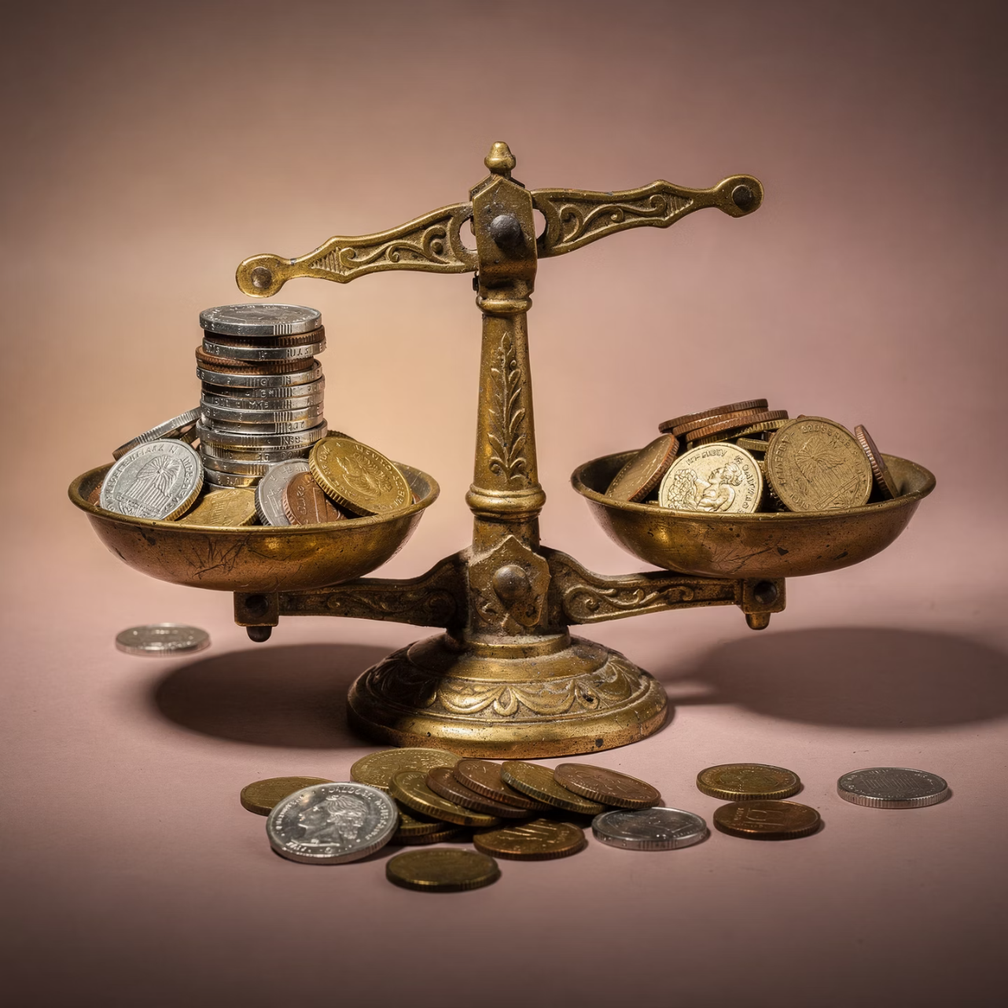
Unit of Account: Measuring Value
A unit of account measures the value of every object in the economy. While it need not be physical, money serves this role in practice.
The value of any object is measured by the number of money units that exchange for one unit of that object—its price or monetary value.
More important than absolute prices are relative prices: the exchange ratio between two goods.

Slide 15
The Complexity of Exchange Ratios
Without money, economies need numerous exchange ratios to describe relative values:
01
02
2 Goods
3 Goods
Only 1 exchange ratio needed (Apples/Bananas)
3 exchange ratios needed (Apples/Bananas, Apples/Cabbages, Bananas/Cabbages)
03
04
4 Goods
n Goods
6 exchange ratios needed
Formula: (1/2)n(n−1) ratios needed

Slide 16
The Power of a Common Yardstick
700
245K
700
CPI Categories
Exchange Ratios
Money Prices
Approximate number of broad category items tracked
Number needed without money as unit of account
Number needed with money—dramatically simpler!
With money as a common measure, we need only n prices instead of approximately n²/2 exchange ratios.

Slide 17
Calculating Relative Prices
Example with 3 goods where 1 Apple = 2 Bananas and 3 Apples = 1 Cabbage:
Good
Money Price
Interpretation
Apples
0.5
Base price
Bananas
0.25
Half an apple's value
Cabbages
1.5
Three times an apple's value
Relative prices: PA/PB = 0.5/0.25 = 2 Bananas per Apple
PC/PA = 1.5/0.5 = 3 Apples per Cabbage

Slide 18
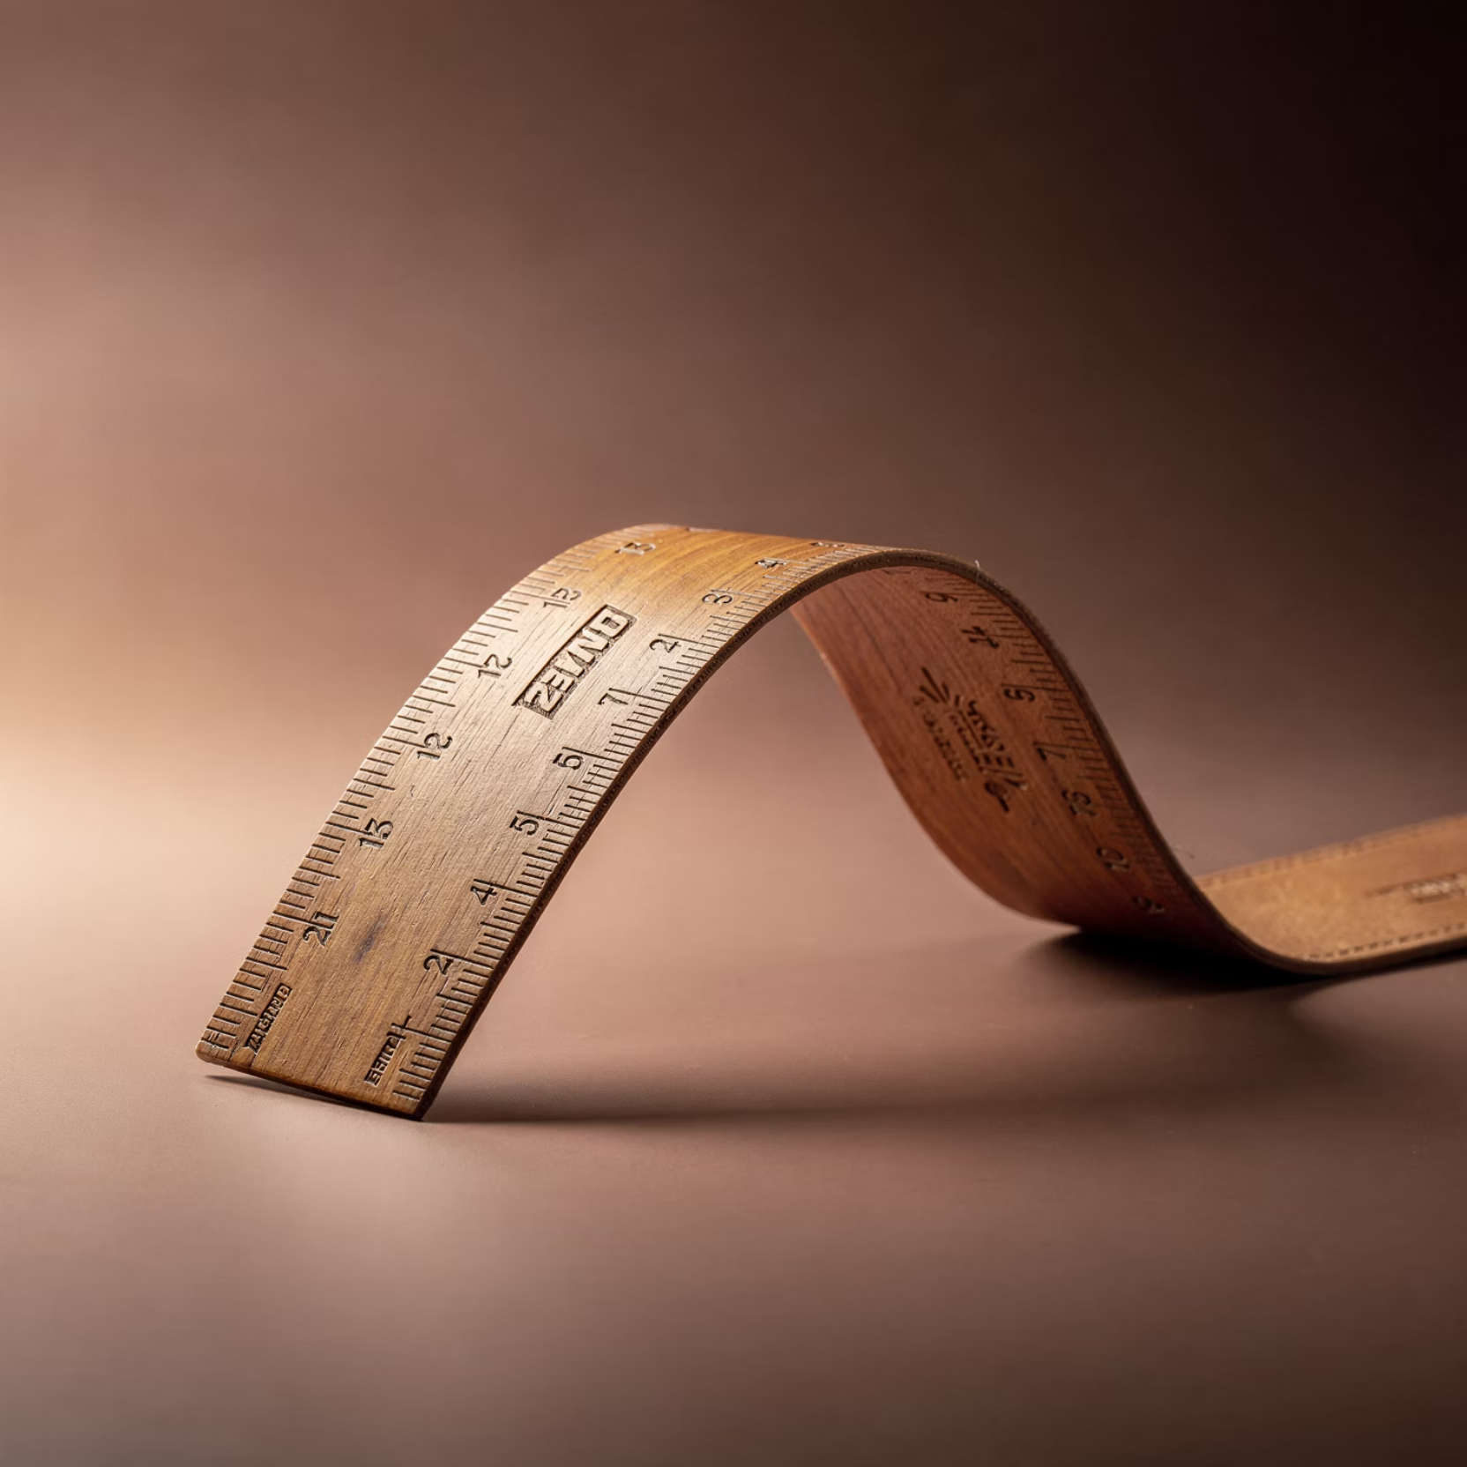
The Imperfect Ruler
Money as a unit of account allows for economy of measurement and record-keeping.
However, unlike a ruler measuring length consistently, money measures value only imperfectly.
Why? Because money's own value is not constant due to inflation.

Slide 19
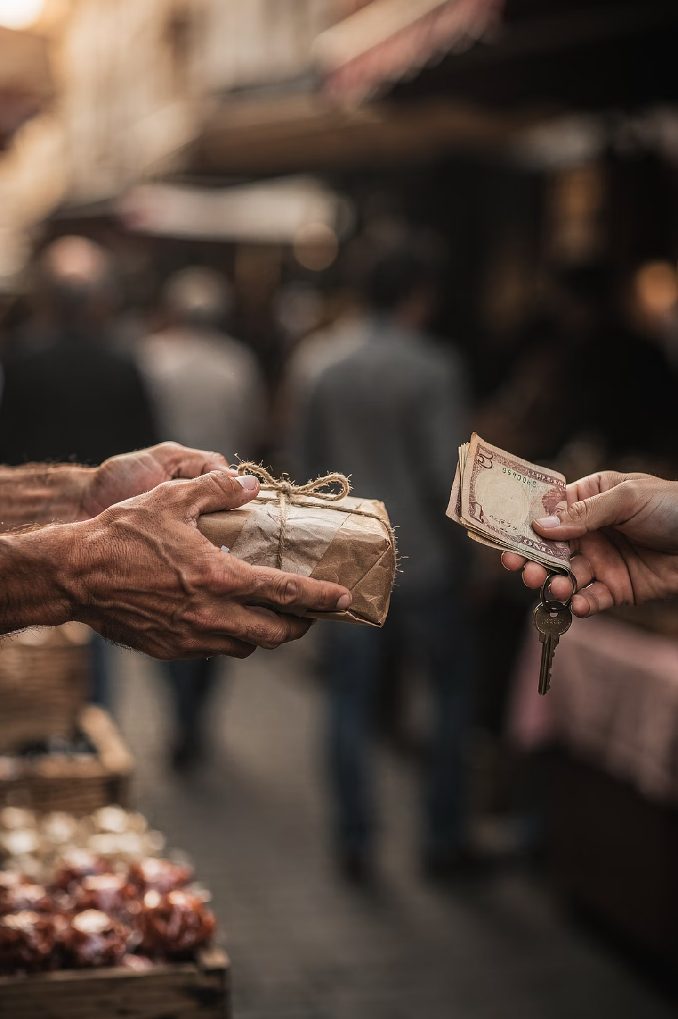
CHAPTER 2
Medium of Exchange
How money transforms the complexity of barter into simple, efficient transactions

Slide 20



Barter vs. Monetary Trade
Barter
Monetary Trade
One-step direct exchange of one good for another
Two-step process: sell for money, then buy with money
At first glance, barter appears simpler. But appearances can be deceiving...

Slide 21

The Double Coincidence of Wants
Barter requires a double coincidence of wants (William Stanley Jevons, 1835-1882).
Two types of frictions impede this coincidence:
Costly Barter
Time and resources spent searching for appropriate trade partners
Misaligned Preferences
Endowments and desires don't match between potential traders

Slide 22

The Search Cost Problem
Finding a trade partner requires more than just matching goods—it requires matching wants.
An agent with Apples who wants Bananas must find someone who has Bananas and wants Apples.
Societies evolved specialized shops to reduce search costs, but without money, even shops face challenges.

Slide 23
Trading Posts Without Money
Without a medium of exchange, we'd need "trading posts" for direct barter between each pair of goods:
2 Commodities
3 Commodities
1 trading post
3 trading posts
4 Commodities
n Commodities
6 trading posts
(1/2)n(n−1) posts
With money, only one shop per commodity is needed—the buyer always pays with money.

Slide 24
The Famous Three-Trader Problem
Consider three traders with misaligned preferences:
Trader
Has
Wants Most
Wants Least
Harriet
3 Apples
6 Bananas
1 Cabbage
Ina
6 Bananas
1 Cabbage
3 Apples
Jamal
1 Cabbage
3 Apples
6 Bananas

Slide 25



The Barter Deadlock
Each trader's endowment equals every other's in value. A three-way swap would make everyone better off.
Ina meets Jamal
2
Jamal prefers his endowment
Harriet meets Ina
1
Ina prefers her own endowment
Jamal meets Harriet
3
Harriet prefers her endowment
Result: No bilateral trade is possible despite mutual gains from exchange!

Slide 26
Money Breaks the Deadlock
Now suppose Harriet also has 1 unit of Money (1M). The following bilateral trades become possible:
Trade 1
Trade 3
Harriet gives 1M to Ina for 6 Bananas
Jamal gives 1M to Harriet for 3 Apples
1
2
3
Trade 2
Ina gives 1M to Jamal for 1 Cabbage
Each trade maintains quid pro quo: 1M = 1C = 3A = 6B. Everyone gets their most preferred bundle!

Slide 27

CHAPTER 3
Store of Value
When money serves as a medium of exchange, it must also function as a store of value during the gap between sales and purchases.

Slide 28
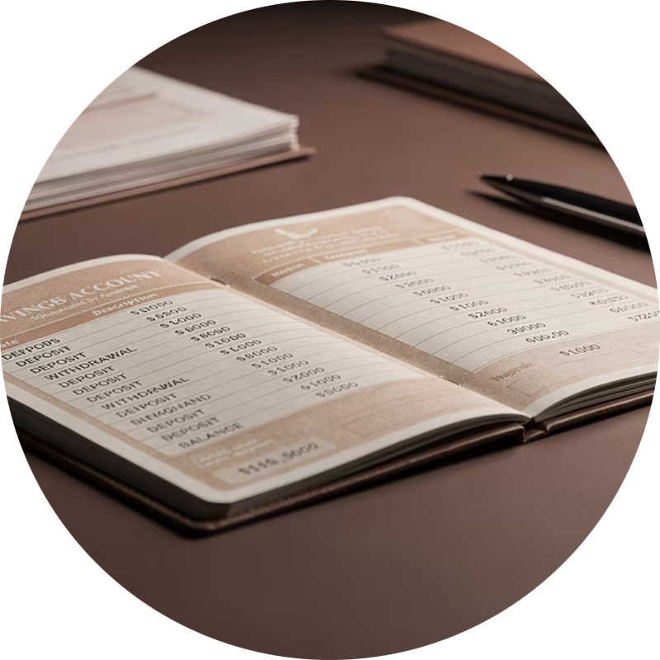
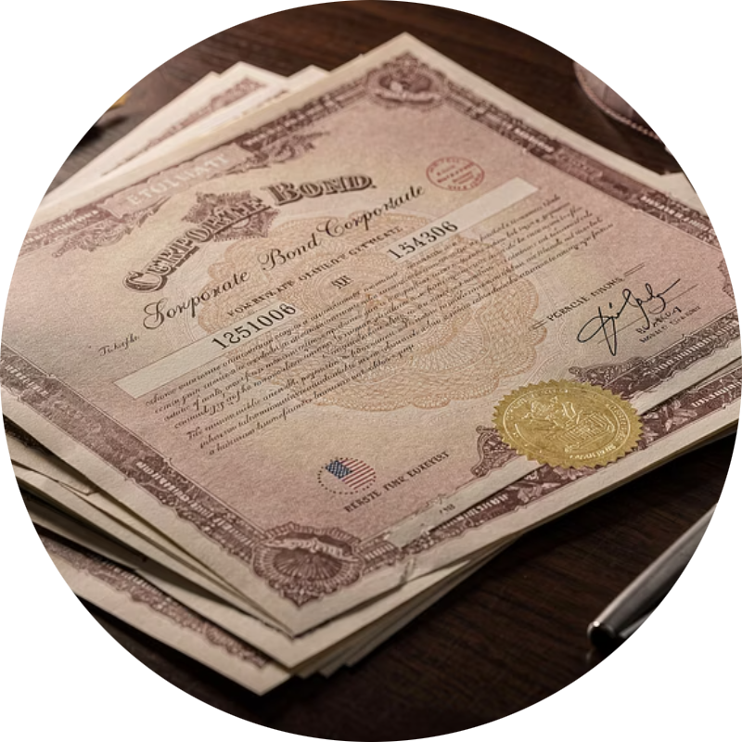
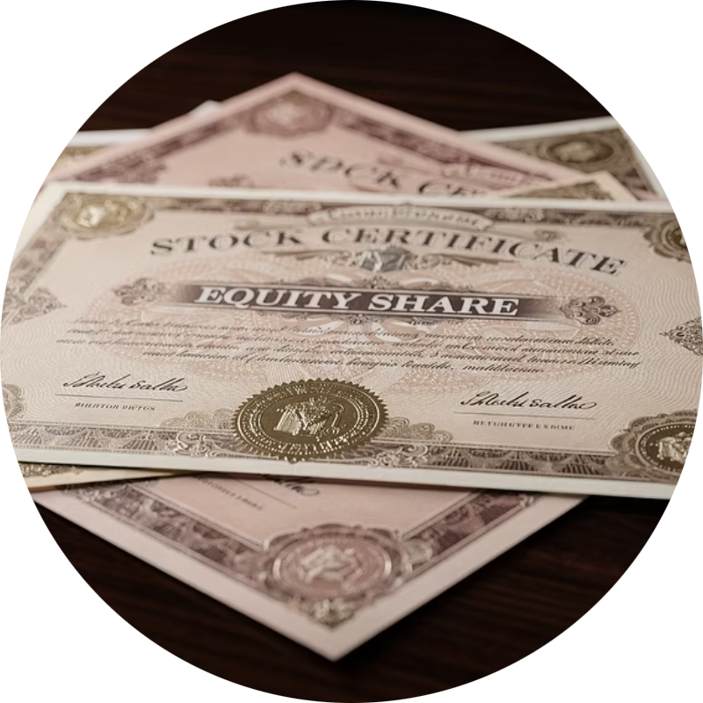

Money Among Other Assets
A medium of exchange is always a store of value, but the converse isn't true.
Savings Deposits
Bonds
Stocks
Property
All are stores of value, but only money serves as the universal medium of exchange.

Slide 29
The Opportunity Cost of Holding Money
Money offers:
Other assets offer:
No financial reward while held
Interest or dividends
Maximum liquidity
Capital appreciation
Convenience in transactions
Other pecuniary rewards
By holding money, people sacrifice the benefits other assets could provide. This is the opportunity cost of holding money.

Slide 30

What Is Liquidity?
The ease with which an asset can be exchanged
A medium of exchange is the most liquid of all stores of value. This liquidity is what economic agents get in return for forsaking interest.

Slide 31
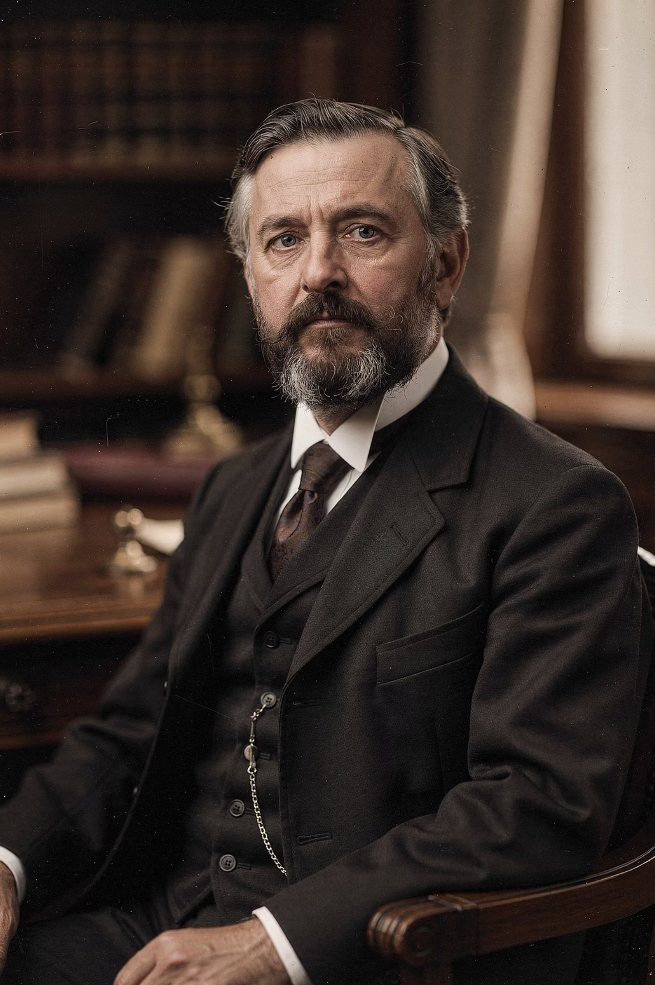
Four Criteria for Liquidity
According to Carl Menger (1840-1921), liquidity depends on:
1
Marketability
Ease of sale; high demand in the market
2
Predictability
Stable and predictable exchange value over time
3
Reversibility
No gap between purchase value and sale value
4
Divisibility
Can be exchanged in arbitrarily small units

Slide 32
The Circularity of Money
Money is universally accepted
2
Because it's the medium of exchange
Money is liquid
1
Because it's universally accepted
Money is the medium of exchange
3
Because it's liquid
Could any arbitrary object serve as money? No—certain objective properties are necessary.

Slide 33




Objective Properties of Money
Transportability
Durability
Easy to move from place to place
Withstands wear and tear over time
Inherent Divisibility
Universal Appeal
Can be broken into smaller units
Acceptable to all parties in transactions

Slide 34
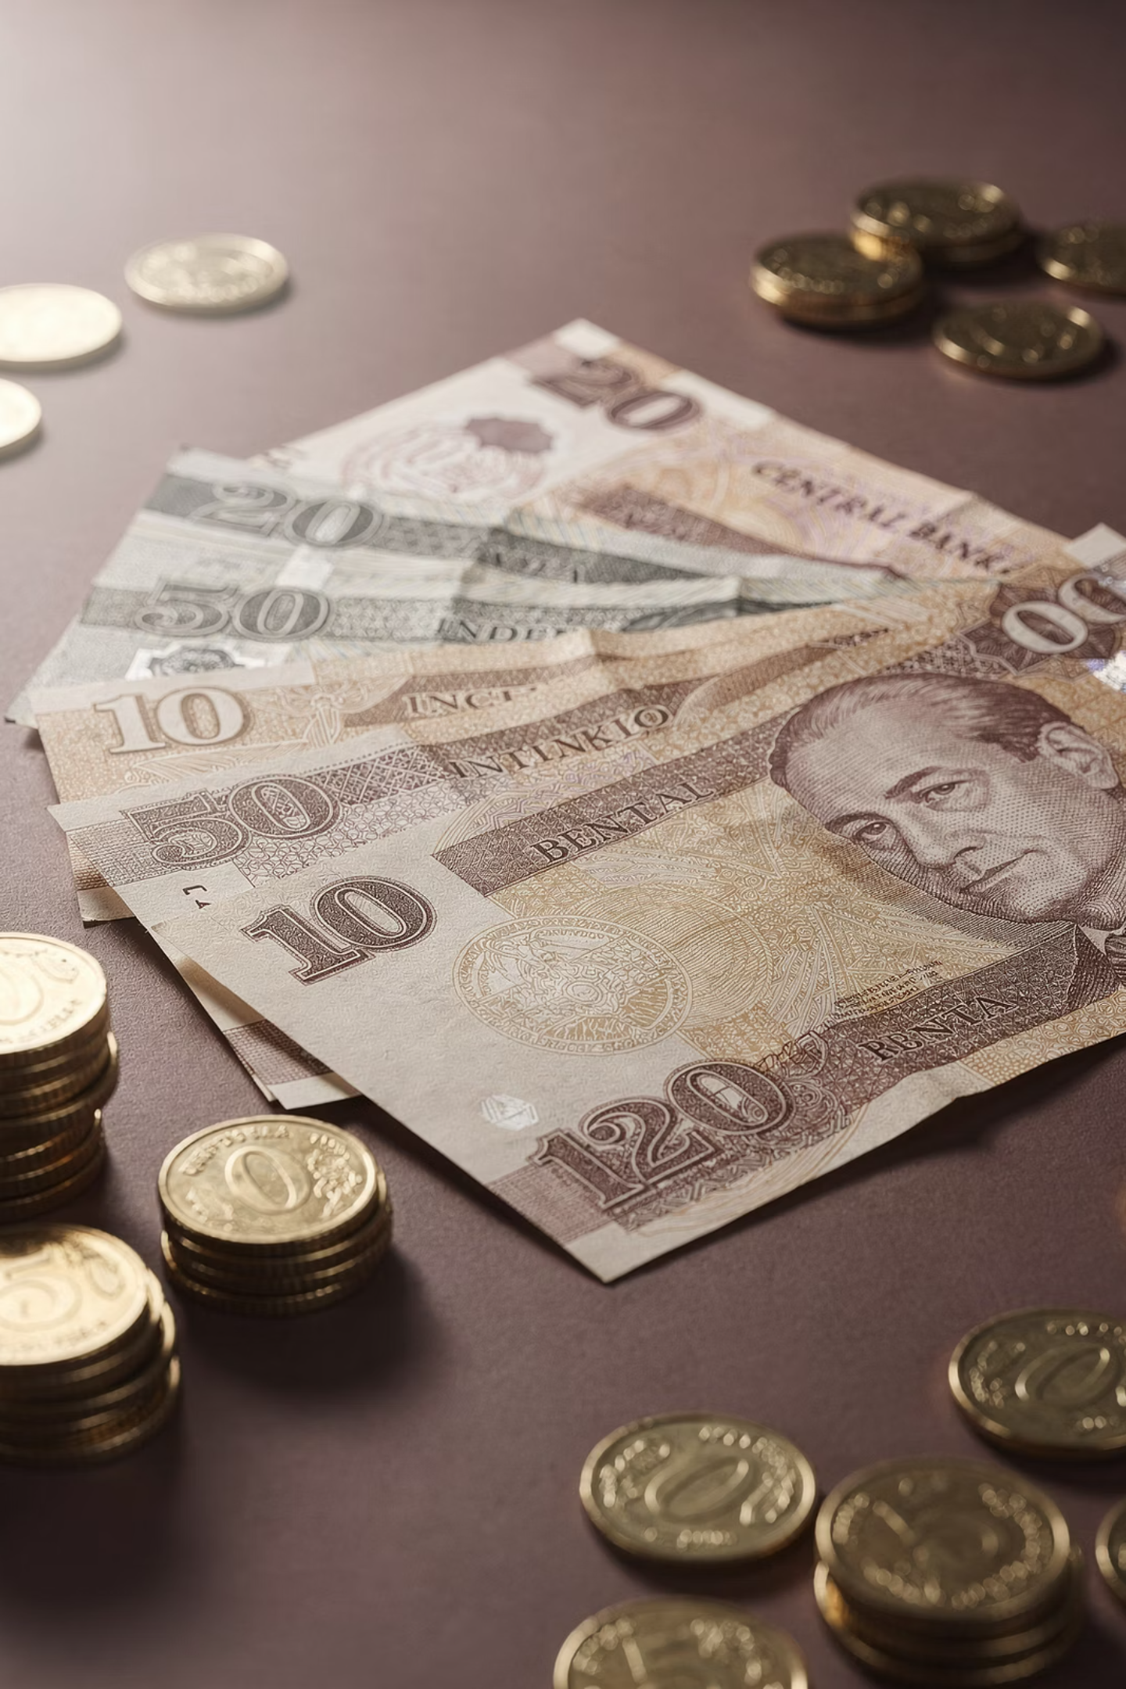
Modern Money: Intrinsically Worthless
In modern economies, money is created by central banks as an artificial object with no intrinsic value.
Yet it meets all objective criteria to serve as a medium of exchange, fulfilling money's three core functions perfectly.

Slide 35
Measures of Money Supply
M0
1
Coins + paper currency (most liquid)
M1
2
M0 + demand deposits (conventional definition)
M2
3
M1 + savings deposits
Higher Aggregates
4
Less liquid, more reward-bearing
As we move to higher aggregates, liquidity shrinks and pecuniary rewards grow.

Slide 36
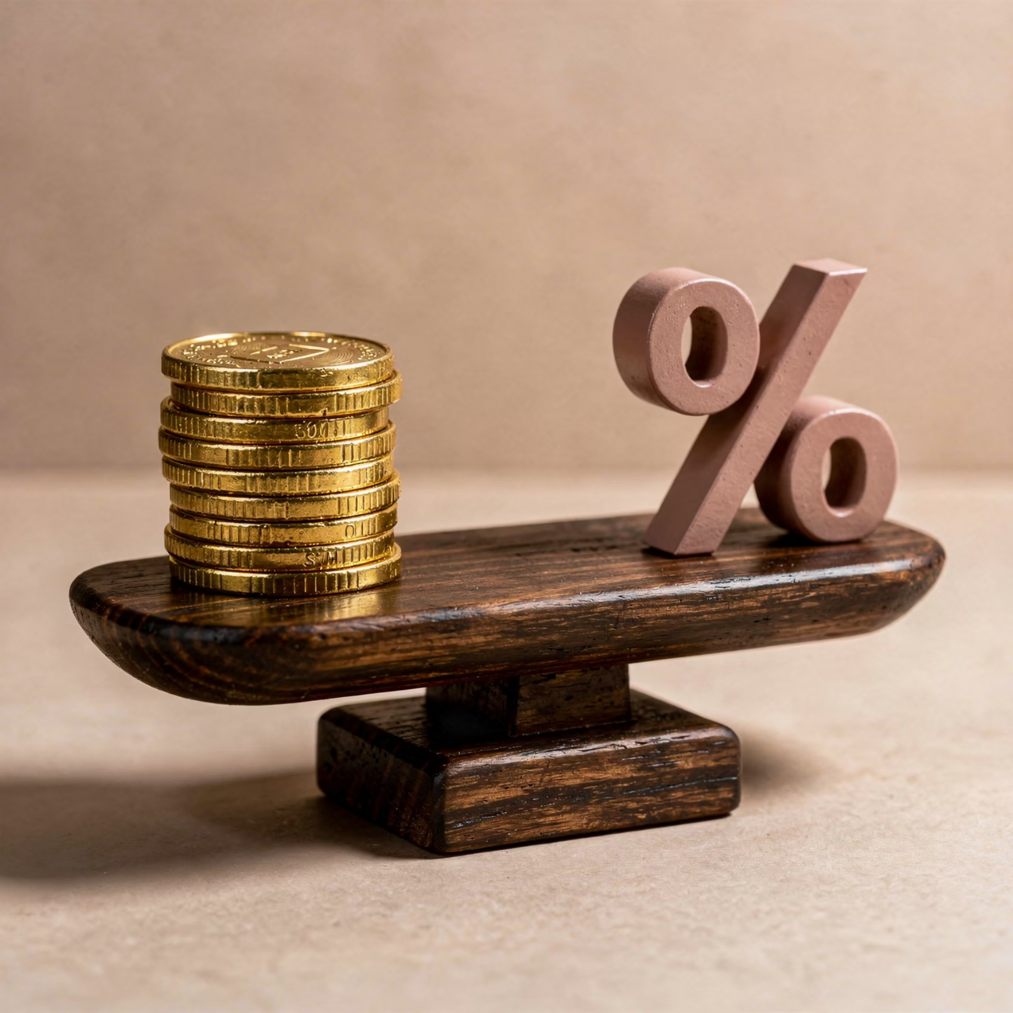
The Liquidity-Interest Tradeoff
People must decide how to store value between interest-bearing assets and money.
This decision involves trading off liquidity for interest (a shorthand for any pecuniary reward).
This tradeoff is central to understanding money's macroeconomic role.

Slide 37
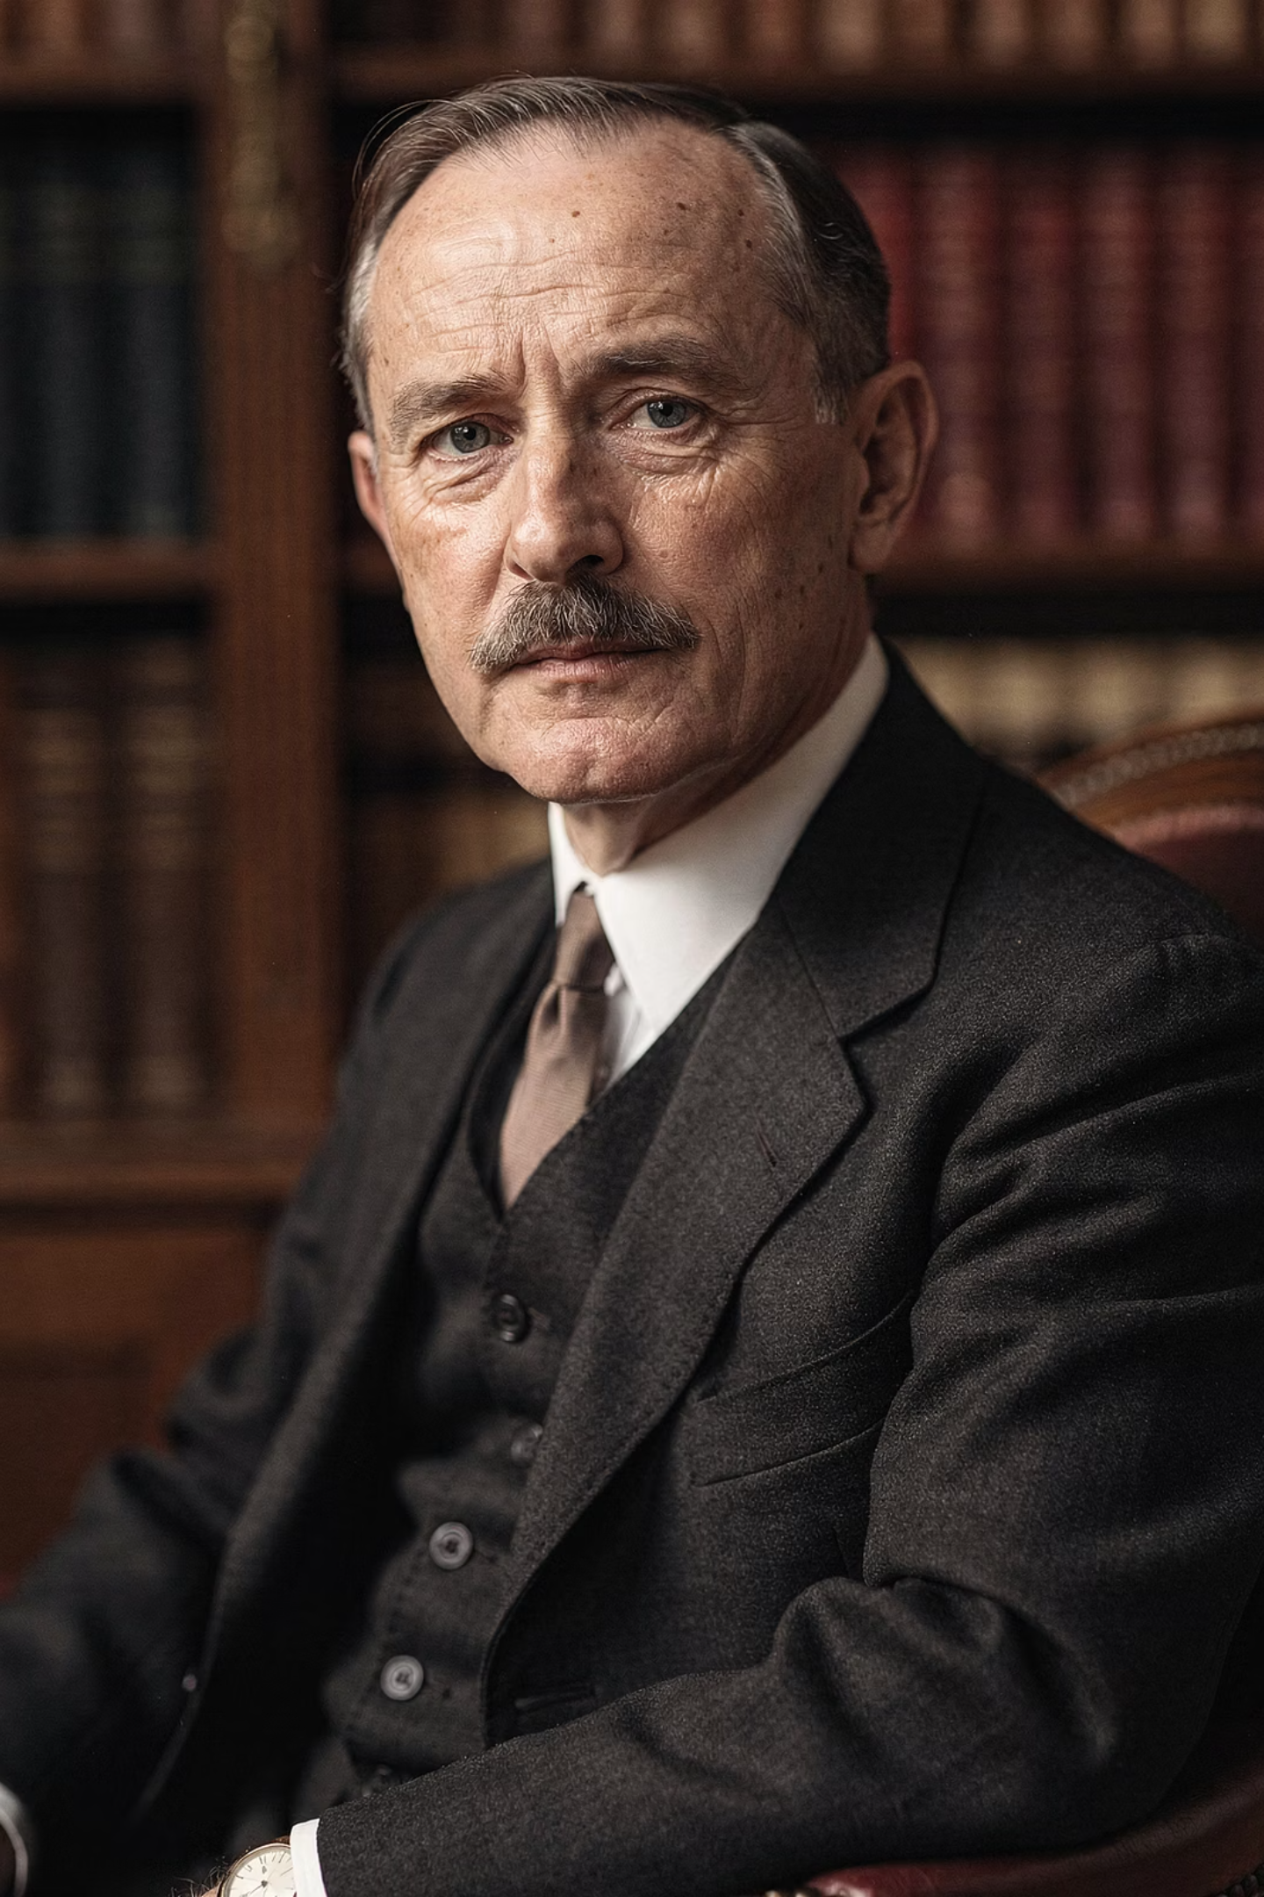
CHAPTER 4
Keynes vs. The Classics
Two fundamentally different views on money's macroeconomic importance

Slide 38


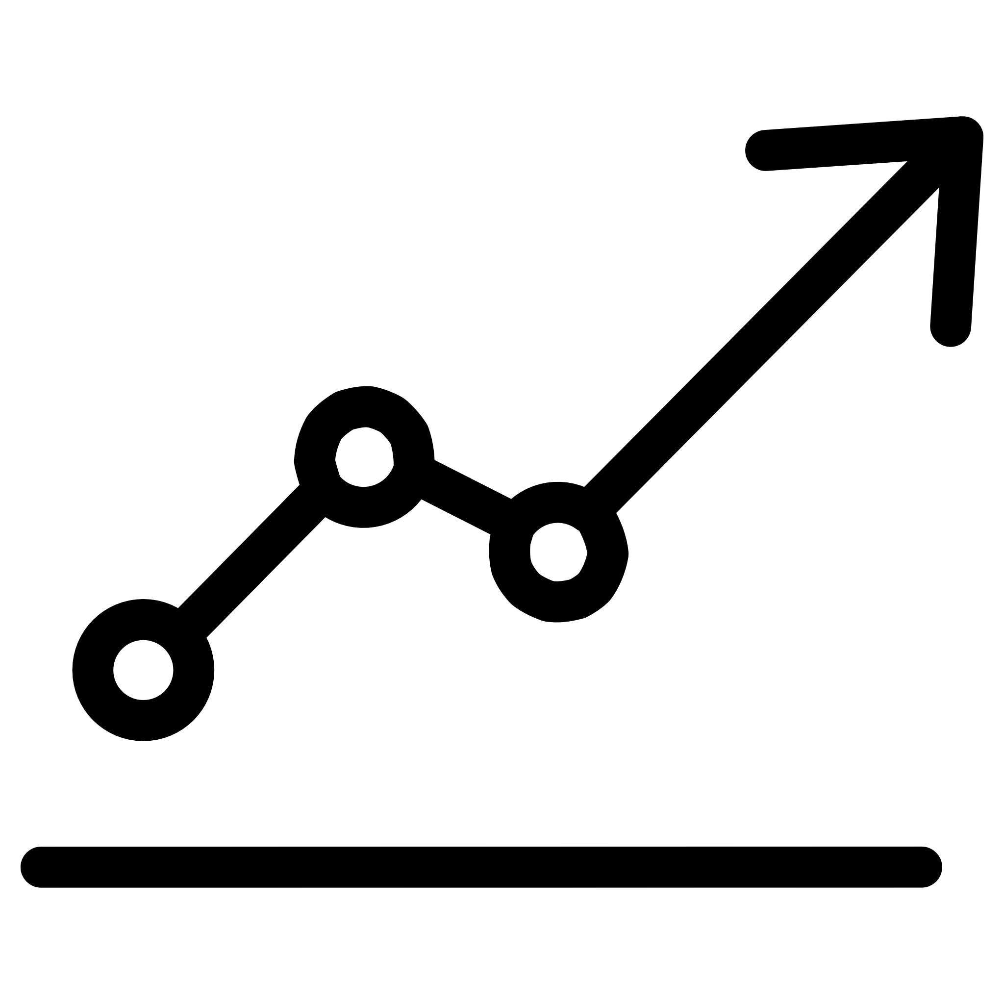
The Keynesian View
Money as More Than Exchange
Spillover Effects
Real Economic Impact
Money interacts with other markets through liquidity demand spillovers
Greater liquidity desire can lower demand for assets and goods
Money's role extends beyond being a medium of exchange or unit of account

Slide 39

The Classical View: Money as a Veil
The Classical school focused on the medium of exchange role and downplayed spillover effects.
Money is a "veil" which appears important on the surface but has no effect on real economic activity.
In the three-trader example, the exact quantity of money was arbitrary—whether 1 unit or 5 units, the real trades remained the same.

Slide 40


The Quantity of Money Matters
In macroeconomic debates, the quantity of money—the level of money supply—plays a central role.
Classical View
Money quantity irrelevant to real outcomes
Keynesian View
Money quantity affects real economic activity through liquidity effects
The rest of this module examines debates emerging from these divergent views on money's macroeconomic importance.

Slide 41
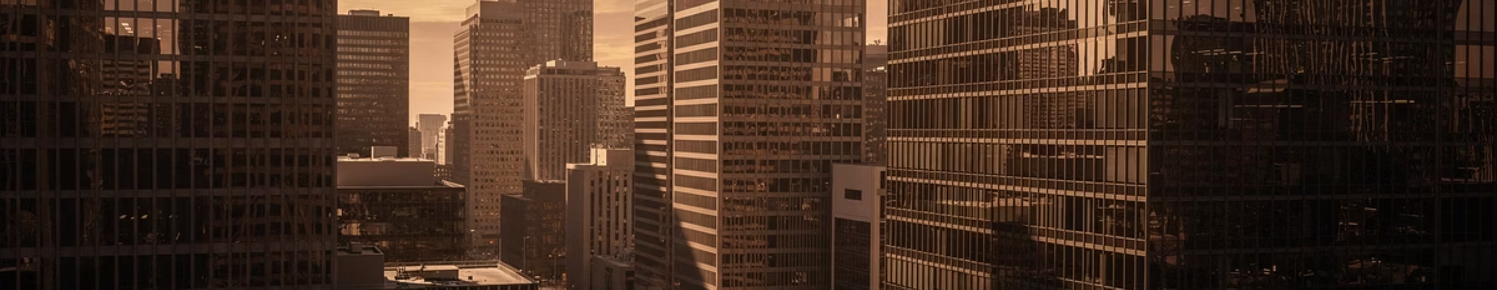
Key Takeaways
Three Functions
Efficiency Gains
Money serves as unit of account, medium of exchange, and store of value
Money dramatically reduces transaction costs compared to barter systems
Liquidity Premium
Macroeconomic Debates
People hold money despite opportunity cost because of its superior liquidity
Keynes and Classics disagree on whether money affects real economic activity

